Slide 1
Parallel and Distributed Computing
CS3006
Lecture 9
OpenMP-II

Slide 2
Review of OpenMP Library Functions
Controlling Number of Threads and Processors
void omp_set_num_threads (int num_threads);
int omp_get_num_threads ( );
int omp_get_max_threads ( );
int omp_get_thread_num ( );
int omp_get_num_procs ( );
int omp_in_parallel ( );
Controlling and Monitoring Thread Creation
void omp_set_dynamic (int dynamic_threads);
int omp_get_dynamic ( );
void omp_set_nested (int nested);
int omp_get_nested ();

Slide 3
OpenMP
#pragma omp directive [clause list]
Notes:
#pragma omp parallel (to create concurrent threads)
#pragma omp for (split parallel iteration space across threads)
#pragma omp sections (when different independent tasks need to be executed on different threads)
Note: if no parallel directive, then for and sections directives would work serially

Slide 4
OpenMP Directives
#pragma omp parallel
#pragma omp for
Notes:
#pragma omp parallel (to create concurrent threads)
#pragma omp for (split parallel iteration space across threads)

Slide 5
One more thing to note
Difference between omp for and omp parallel
1 #pragma omp parallel
2 {
3 #pragma omp for
for (i = 0 < i < n; i++) {
//omp for schedules/distributes itterations between the threads
5 /* body of parallel for loop */
6 }
7 }
is same as
1 #pragma omp parallel for
3 for (i = 0 < i < n; i++) {
4 /* body of parallel for loop */
6 }

Slide 6
Some Useful Clauses in OpenMP
A clause is an optional, additional component to a pragma
Private: The private clause directs the compiler to make one or more variables private
int k=3;
#pragma omp parallel for default(shared) private(j) shared(k)
for (i = 0; i < n; i++)
for (j = 0; j < n; j++)
a[i][j] = MIN(a[i][j],a[i][k]+tmp);
Comments:
Here the private variable j is undefined -
when this parallel construct is entered
when this parallel construct is exited

Slide 7
Some Useful Clauses in OpenMP
firstprivate: It directs the compiler to create private variables having initial values identical to the value of the variable controlled by the master thread as the loop is entered.
s = complex_function();
#pragma omp parallel for firstprivate(s) num_threads(2)
for (i = 0 ; i < n ; i ++) (
s = s*omp_get_thread_num();
printf(“S is %d at thread#%d\n”, s,omp_get_thread_num());
}

Slide 8
Some useful clauses
lastprivate:
consider the following code
s = complex_function();
#pragma omp parallel for private(j) firstprivate(s)
for (i = 0 ; i < n ; i ++) (
s += 1
}
printf(“s after join:%d\n”,s); //undefined value
--------------------------------------------------------------------------------------------------

Slide 9
Some Useful Clauses in OpenMP
lastprivate: used to copy back to the master thread’s copy of the variable, the private copy of the variable from the thread that executed the last iteration.
s = complex_function();
#pragma omp parallel for private(j) firstprivate(s) lastprivate(s)
for (i = 0 ; i < n ; i ++) (
s +=1;
}
printf(“s after join:%d\n”,s);//value of s as it was for last iteration of the loop

Slide 10
Reduction clause
Reductions are so common that OpenMP provides support for them
May add reduction clause to parallel for pragma
Specify reduction operation and reduction variable
OpenMP takes care of storing partial results in private variables and combining partial results after the loop
The reduction clause has this syntax: reduction (<op> :<variable>)
Operators
+ Sum
* Product
& Bitwise and
| Bitwise or
^ Bitwise exclusive or
&& Logical and
|| Logical or

Slide 11
Reduction clause
double area, pi, x;
int i, n;
...
area = 0.0;
#pragma omp parallel for private(x) reduction(+:area)
for (i = 0; i < n; i++) {
x = (i+0.5)/n;
area += 4.0/(1.0 + x*x);
}
pi = area / n;

Slide 12
Conditional Parallelism Clause
if Clause: The if clause gives us the ability to direct the compiler to insert code that determines at run-time whether the loop should be executed in parallel or not.
The clause has this syntax: if (<scalar expression> )
double area, pi, x;
int i, n;
...
area = 0.0;
#pragma omp parallel for private(x) reduction(+:area) if(n>5000)
for (i = 0; i < n; i++) {
x = (i+0.5)/n;
area += 4.0/(1.0 + x*x);
}
pi = area / n;

Slide 13
Scheduling Loops (a clause)
Scheduling the loops means dividing number of iterations between the processes.
Syntax of schedule clause
schedule (<type>[,<chunk> ])
Schedule type is required but, chunk size optional
A chunk is a contiguous range of iterations
Increasing chunk size reduces scheduling overhead and may increase cache hit rate [due to operations on contiguous memory locations]
Decreasing chunk size allows finer balancing of workloads

Slide 14
Scheduling Loops
Static: schedule(static[, chunk-size])
Splits the iteration space into equal chunks of size chunk-size and assigns them to threads in a round-robin fashion.
When no chunk-size is specified, the iteration space is split into as many chunks as there are threads (i.e., size of each is n/tot.threads) and one chunk is assigned to each thread.
Decision about work division is done before actually executing the code.
Results in lower scheduling overhead. But, can cause load-imbalance if all processors are not of same compute-capability.

Slide 15
Scheduling Loops
Static: schedule(static[, chunk-size])
Example when reducing chunk size improves load-balancing
#pragma omp parallel for private (j) schedule(static, 1)
for (i = 0; i < n; i++)
for ( j = i; j < n; j++)
a[i][j] = complex_func(i,j);

Slide 16
Scheduling Loops
Dynamic: schedule(dynamic[, chunk-size])
The iteration space is partitioned into chunks given by chunk-size
Initially every thread is assigned single chunk. The decision for remaining iteration chunks is done on run-time
This means chunk is assigned to threads as they become idle.
This takes care of the temporal imbalances resulting from static scheduling.
If no chunk-size is specified, it defaults to a single iteration per chunk

Slide 17
Scheduling Loops
Guided:
schedule(guided, C): dynamic allocation of chunks to tasks using guided self-scheduling heuristic. Initial chunks are bigger, later chunks are smaller, minimum chunk size is C.
schedule(guided): guided self-scheduling with minimum chunk size 1
schedule(runtime): schedule chosen at run-time based on value of OMP_SCHEDULE env variable.

Slide 18
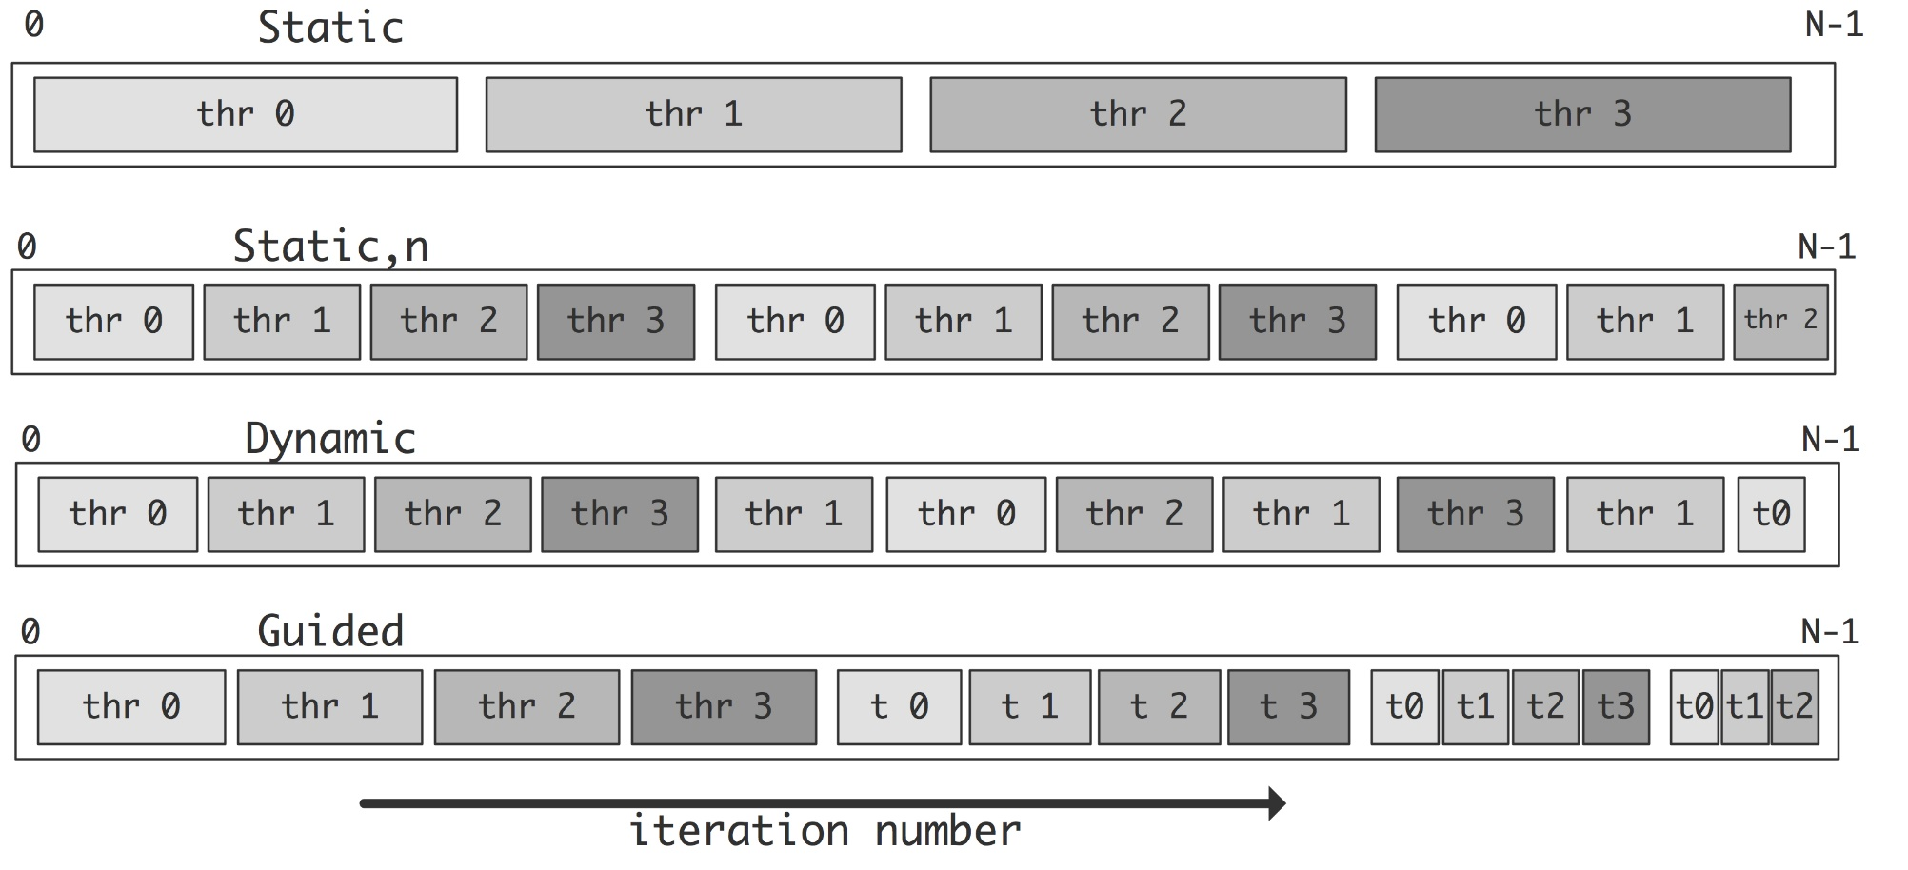
Scheduling Loops(Summary)

Slide 19
No Wait Clause
In order to avoid implicit barrier
A thread can easily move to next after completed its assign task/iterations
#pragma omp parallel for nowait

Slide 20
Functional / Task Parallelism in OpenMP

Slide 21
Functional/Task Parallelism
#pragma omp sections [clause list]
Notes:
#pragma omp parallel (to create concurrent threads)
#pragma omp for (split parallel iteration space across threads)
#pragma omp sections (when different independent tasks need to be executed on different threads)
Note: if no parallel directive, then for and sections directives would work serially

Slide 22
Functional/Task Parallelism
If your code is based on different segments or sections that can be executed in parallel.
Also known to as task parallelism
α
β
v = alpha();
W = beta();
x = gamma(v,w);
y = delta();
printf(“%6.2f\n”,epsilon(x,y));
Can execute alpha, beta, delta parallelly
Remaining ones are executed sequentially according to the dependency.
γ
δ
ε

Slide 23
parallel sections, section pragmas
#pragma omp parallel sections
{
#pragma omp section //[optional for 1st block]
v = alpha();
#pragma omp section
W = beta();
#pragma omp section
y = delta();
}
x = gamma(v,w);
printf(“%6.2f\n”, epsilon(x,y));
#pragma omp parallel sections creates a team of threads which executes the sections in the region parallelly
Sections that can be executed parallel are preceded by ‘omp section’ pragma.

Slide 24
Functional Parallelism
Another approach
α
β
v = alpha();
W = beta();
x = gamma(v,w);
y = delta();
printf(“%6.2f\n”,epsilon(x,y));
Execute alpha and beta in parallel.
Execute gamma and delta in parallel
γ
δ
ε

Slide 25
omp sections pragma
Appears inside a parallel block of code
This pragma distributes enclosed sections among the threads in the team
The difference between omp parallel sections and omp sections is that,
Omp parallel sections generate its own team of threads
While simple omp sections pragma uses existing team of threads and distributes section among the threads
If multiple sections pragmas are inside one parallel block, may reduce fork/join costs

Slide 26
sections pragma
#pragma omp parallel num_threads(2)
{
#pragma omp sections
{
#pragma omp section //optional
v = alpha();
#pragma omp section
w = beta();
} // here an implicit barrier exists
#pragma omp sections
{
x = gamma(v, w);
#pragma omp section
y = delta();
}
}
printf ("%6.2f\n", epsilon(x,y));

Slide 27

Questions

Slide 28
References
Kumar, V., Grama, A., Gupta, A., & Karypis, G. (2017). Introduction to parallel computing. Redwood City, CA: Benjamin/Cummings.

